Slide 1
Railway Reservation System
SUBMITTED BY: SAURABH KISHOR Reg No: 19CS1100 Dept: CSE

Slide 2
Railway Reservation System jBy: Saurabh Kishor (19CS1100, CSE-2)
Introduction:
The title of the project is Railway Reservation system.
In this project a person can check the availability of a train and book tickets by entering the boarding point and destination.
A ticket will be printed containing the PNR number.
The PNR Number can also be used for cancellation of the ticket.
In Admin Section of the project ( with the help of a
Password) Admin staff i.e., ticket collector or other Railway’s Staff can enter new train record, display all train records, modify train records and delete train records

Slide 3
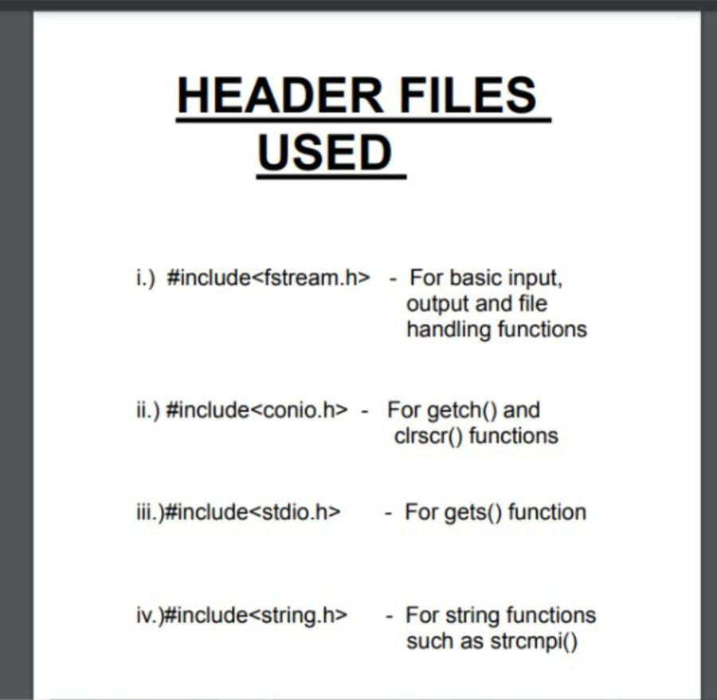

Slide 4
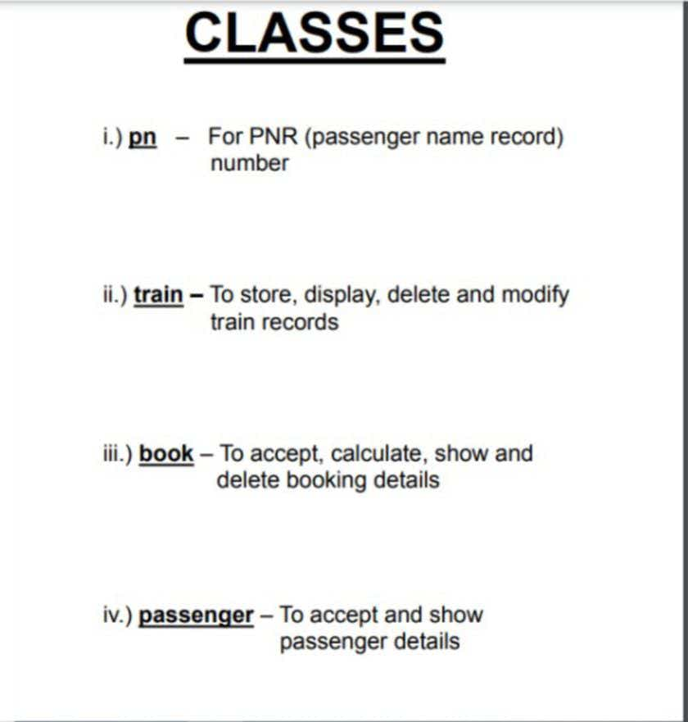

Slide 5
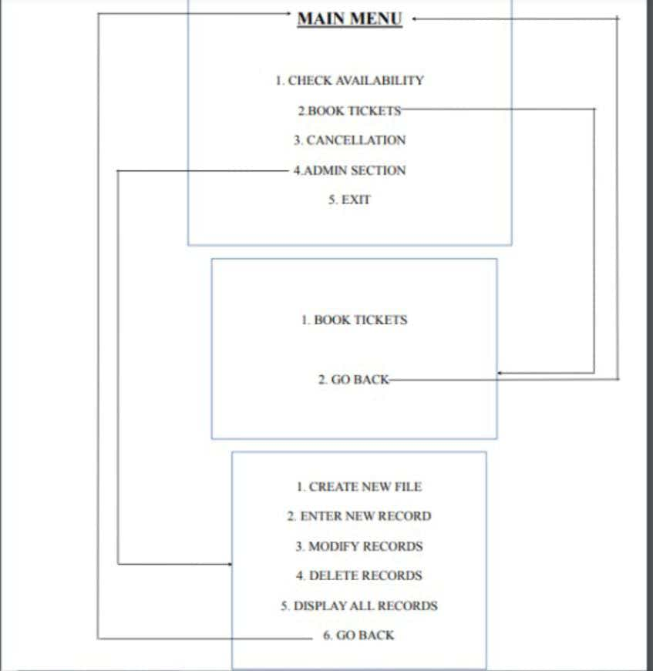

Slide 6
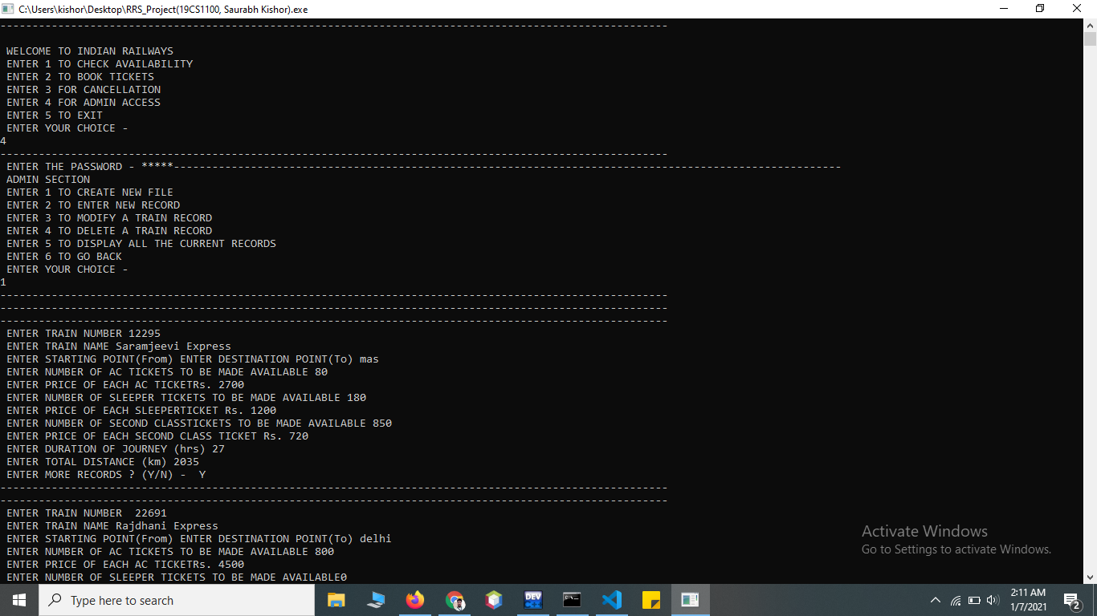
Sample Output

Slide 7
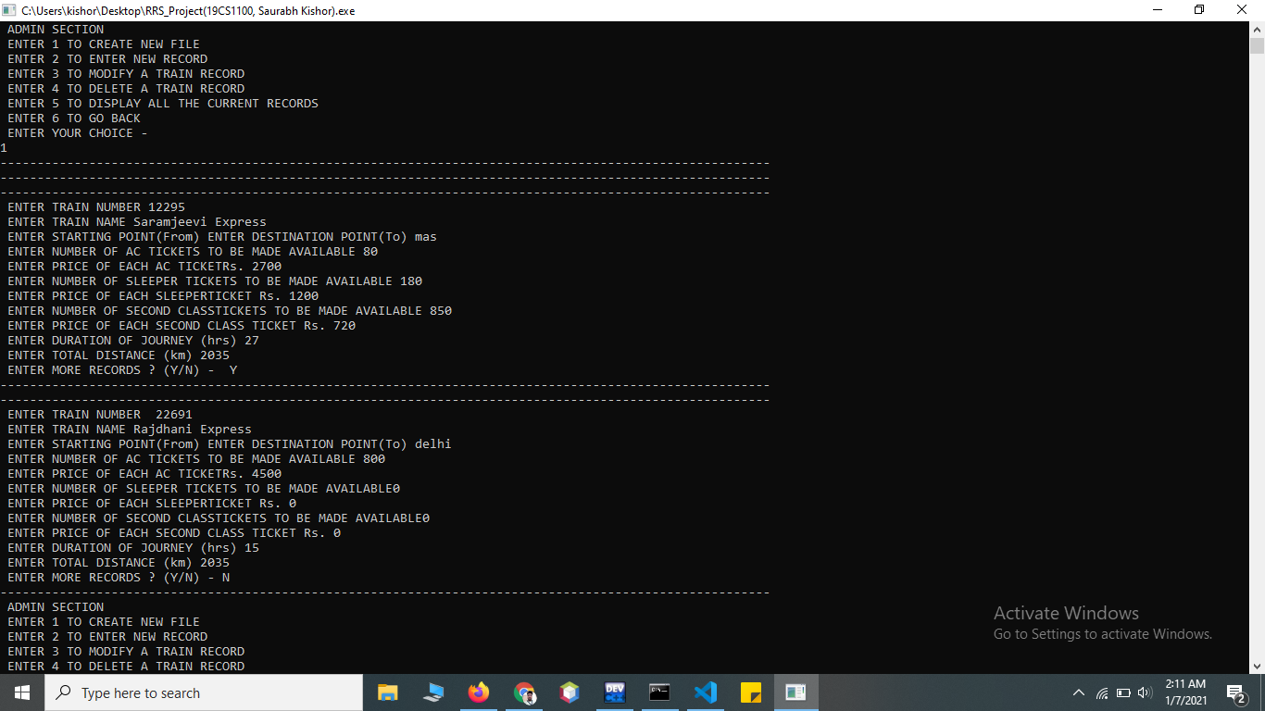

Slide 8
Thank You

